Slide 1
FROG SPECIES PREDICTION
EXPLORATORY DATA ANALYSIS
MACHINE LEARNING

Slide 2
Total sum of Species in each continent
Australia has the highest number of species followed by Central America and then Africa

Slide 3

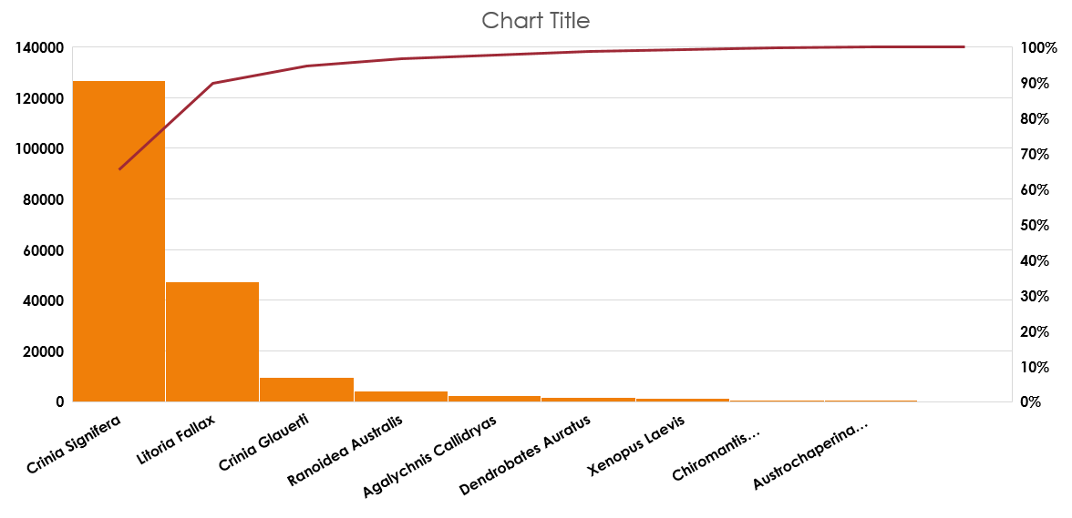
Total number per specie

Slide 4
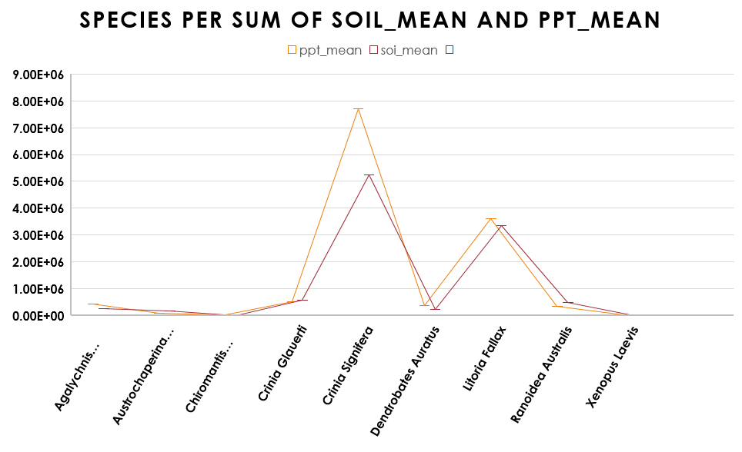

Slide 5
MACHINE LEARNING

Slide 6
ML PARAMETERS
The model KNeighborsClassifier was used from the library scikit learn
N neighbors = 5
Split data = 80%
Test data = 20&
Accuracy = 0.93

